Slide 1
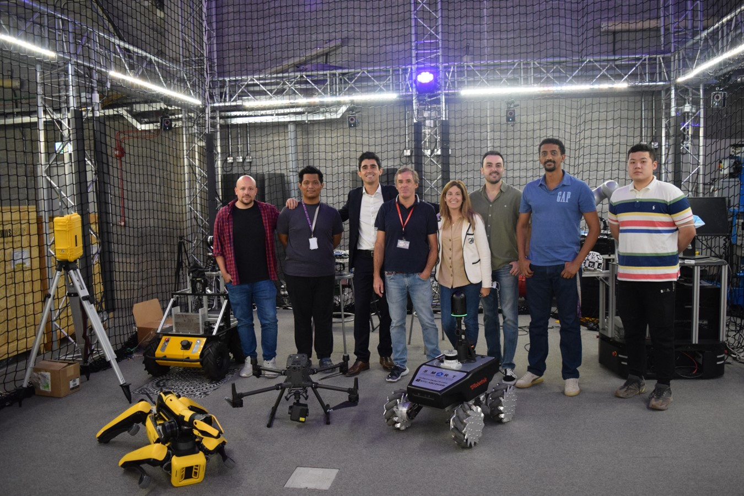




Robotics Research
at S.M.A.R.T.
Part 1 of 2
Borja García de Soto, PhD, PE

Slide 2


Sustainable and resilient construction
Overview
Modularization and lean construction
Our goal is to bridge scholarly excellence with practical application, optimizing every stage of the infrastructure lifecycle to build resilient future communities.
Artificial intelligence
Robotic systems and automation
Technology integration & information modelling

Slide 3
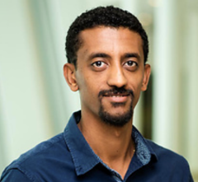

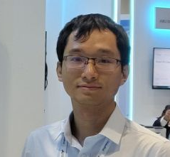




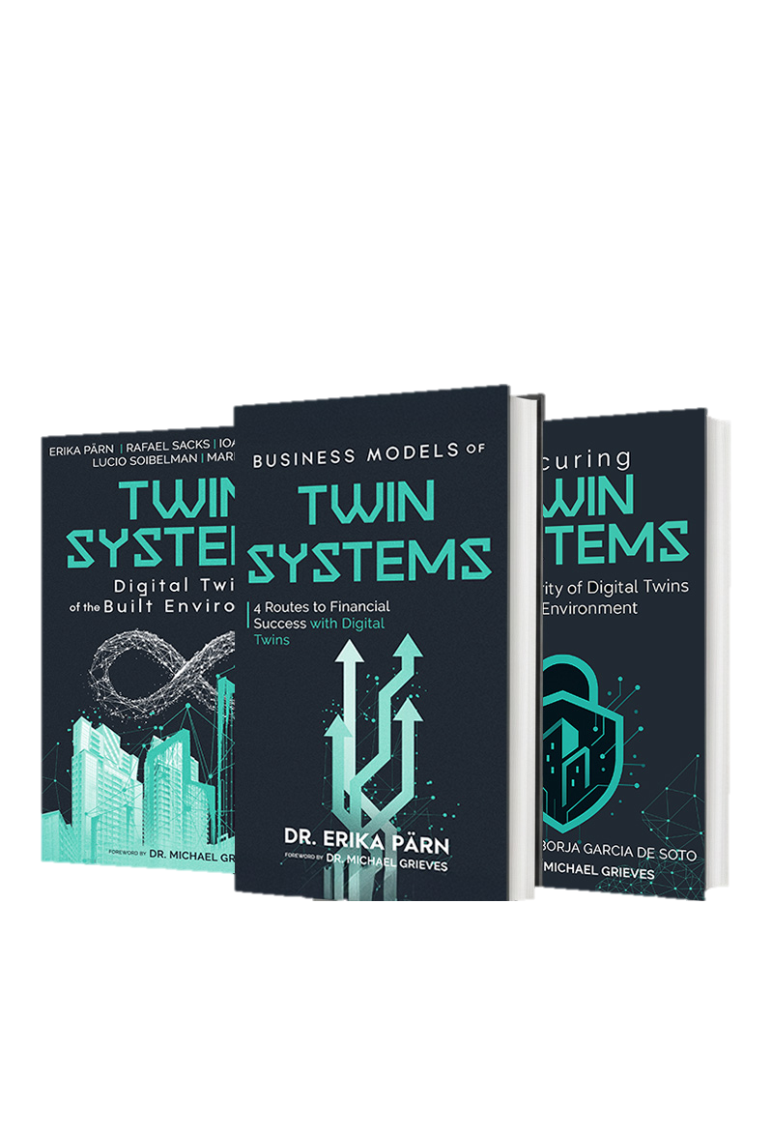



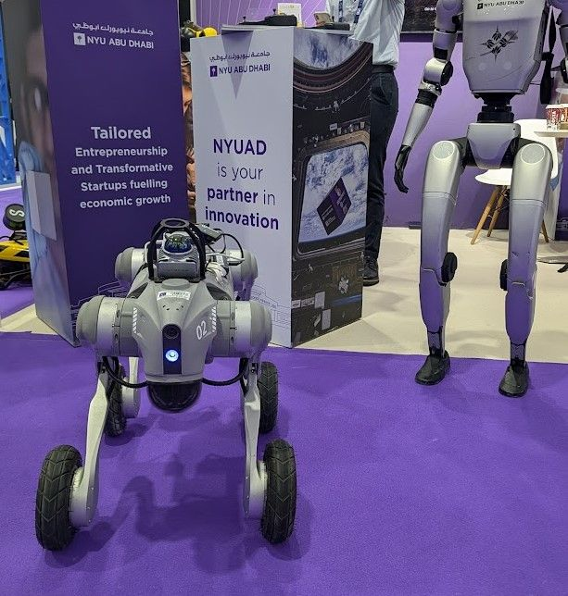
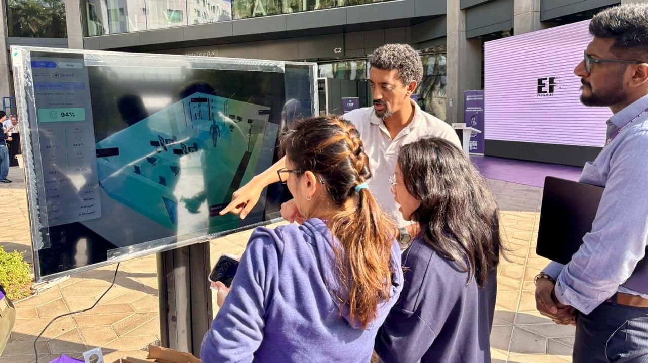

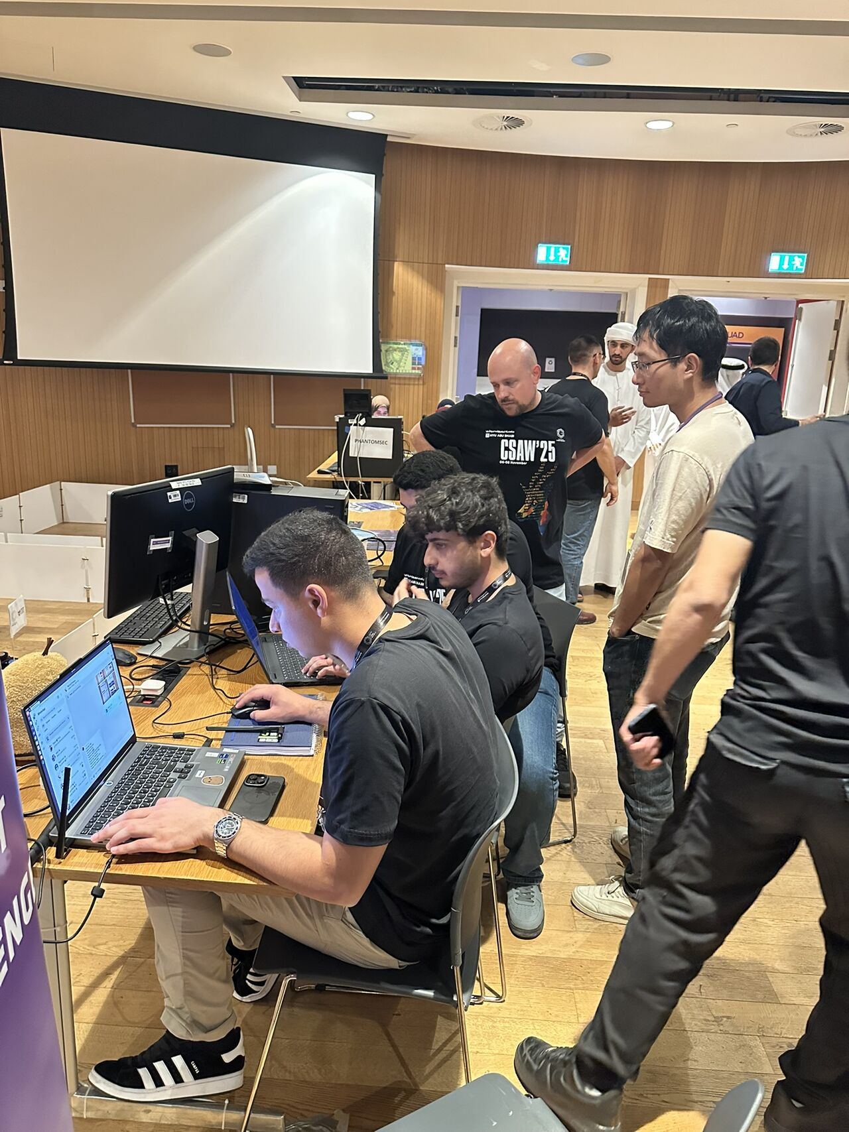
Research Team | people Of S.M.A.R.T. Labs
Borja García De Soto
Eyob Mengiste
Erika A. Pärn
Zihao Zheng
Associate Professor
Instructor and Researcher
Research Scientist
Postdoctoral Associate
Semih Sonkor
Dongchi (Daniel) Yao
Nas Gopee
Boyu Wang
PhD Student
Postdoctoral Associate
Research Assistant
Postdoctoral Associate

Slide 4
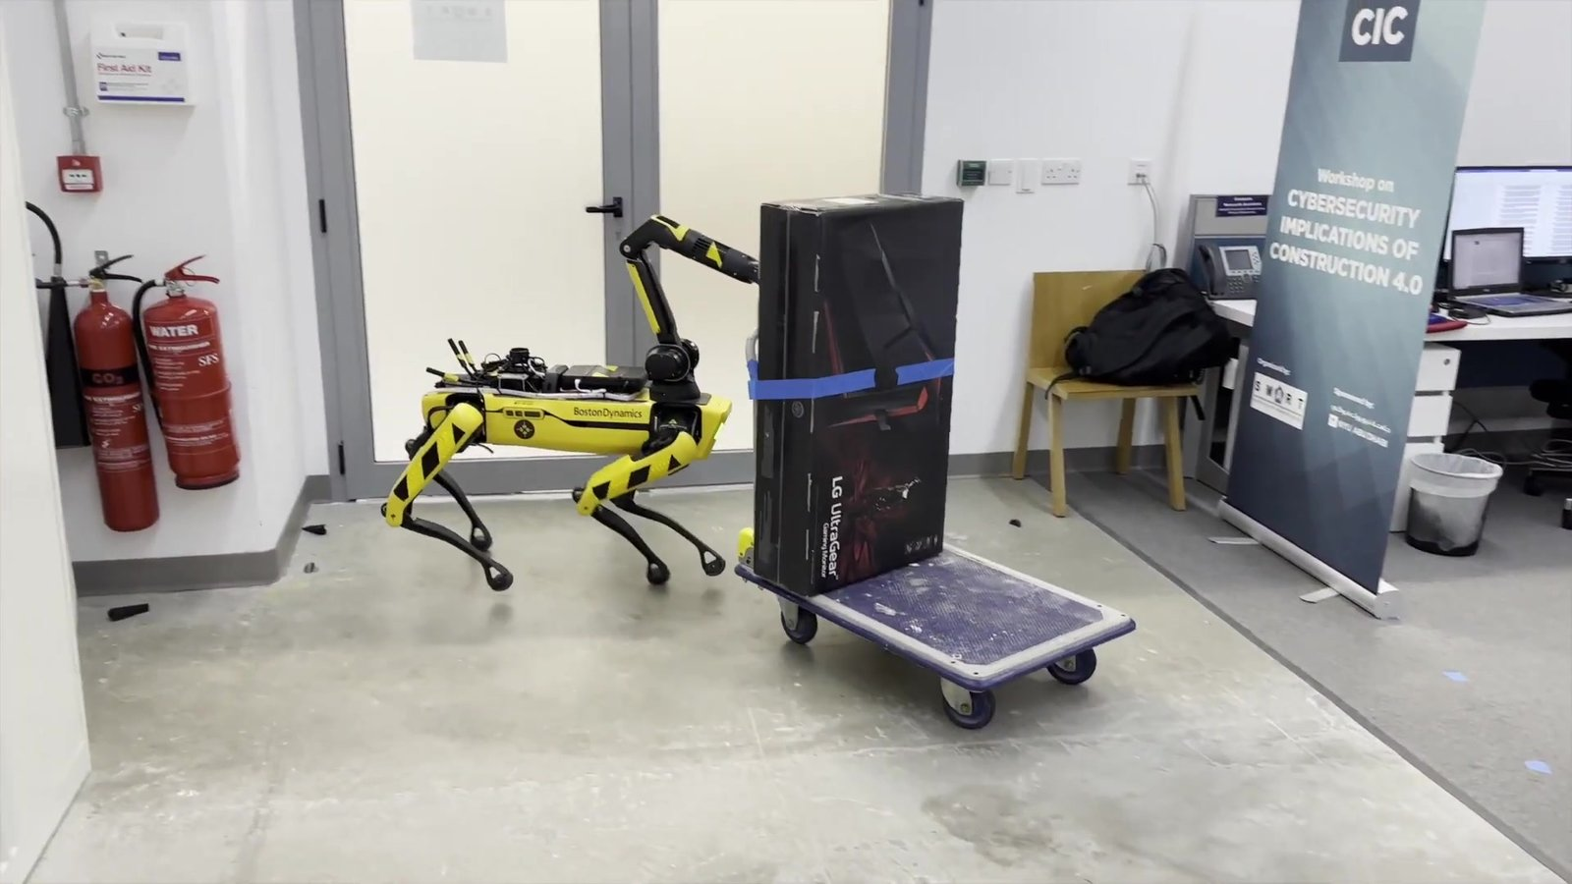
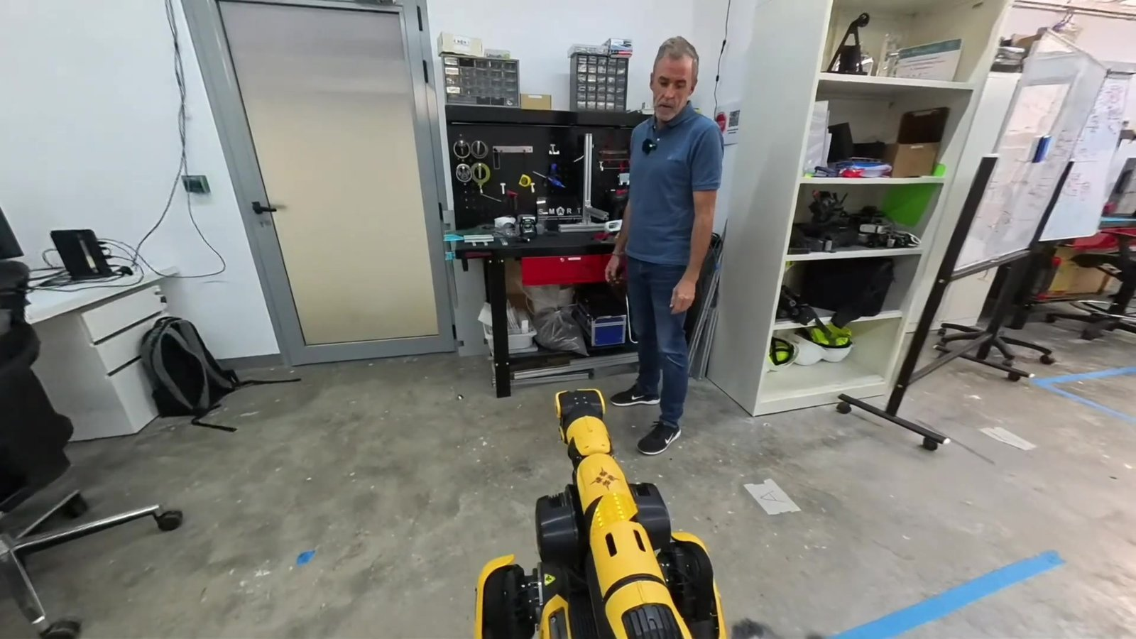
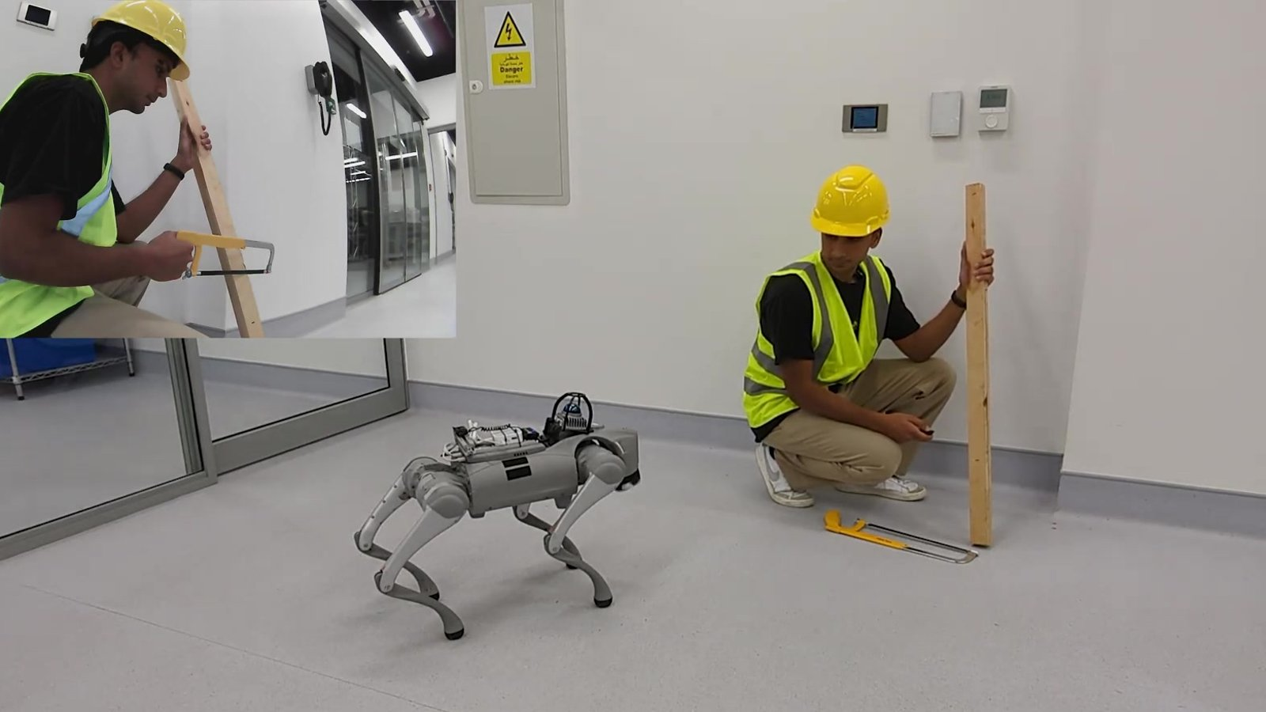
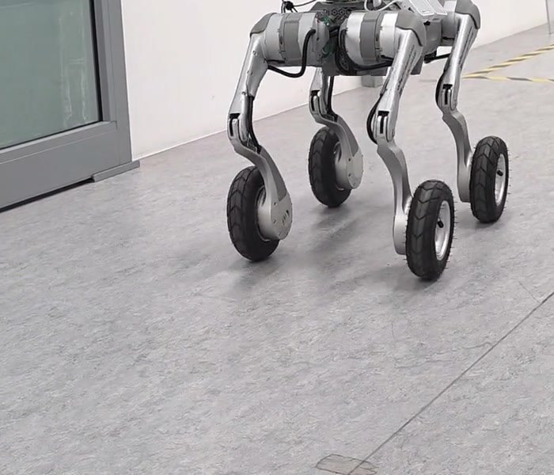
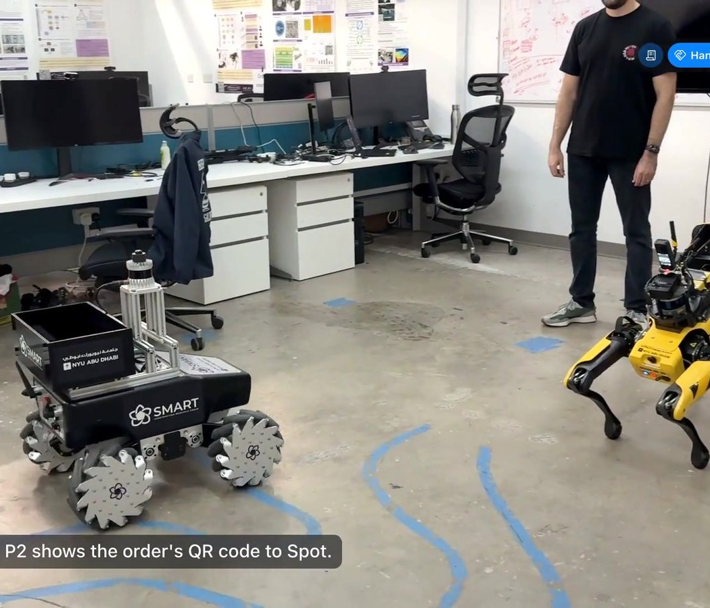
Our Robotics Research | Overview
02
Multi-Agent Robotic System
03
PACA
04
LISA
05
SiteScope
06
Logistics Challenge
Robots and a human split the work to digitize a cluttered site.
Workers talk to a robot assistant; a cloud multimodal LLM plans its actions.
The same idea running locally: private, offline, speech-driven safety checks.
Schedule-driven robot inspections, from capture to published report.
Three robots and five people fill delivery orders together.
SUMMIT-XL · Spot with Arm
Spot with Arm
Go2 · Go2-W
Go2-W
SUMMIT-XL · Spot · FR3 arm
J. Field Robotics 2024
ICRA 2025 Workshop
CCC 2025 · AutCon 2026
IROS 2026 Workshop
Lab demonstration

Slide 5

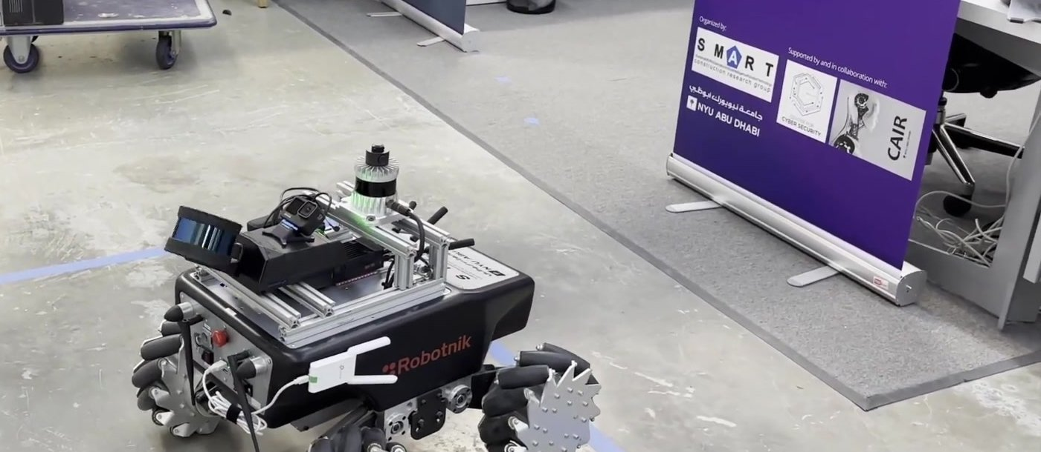

01
Robotic Platforms:
Our Robot Fleet

Slide 6
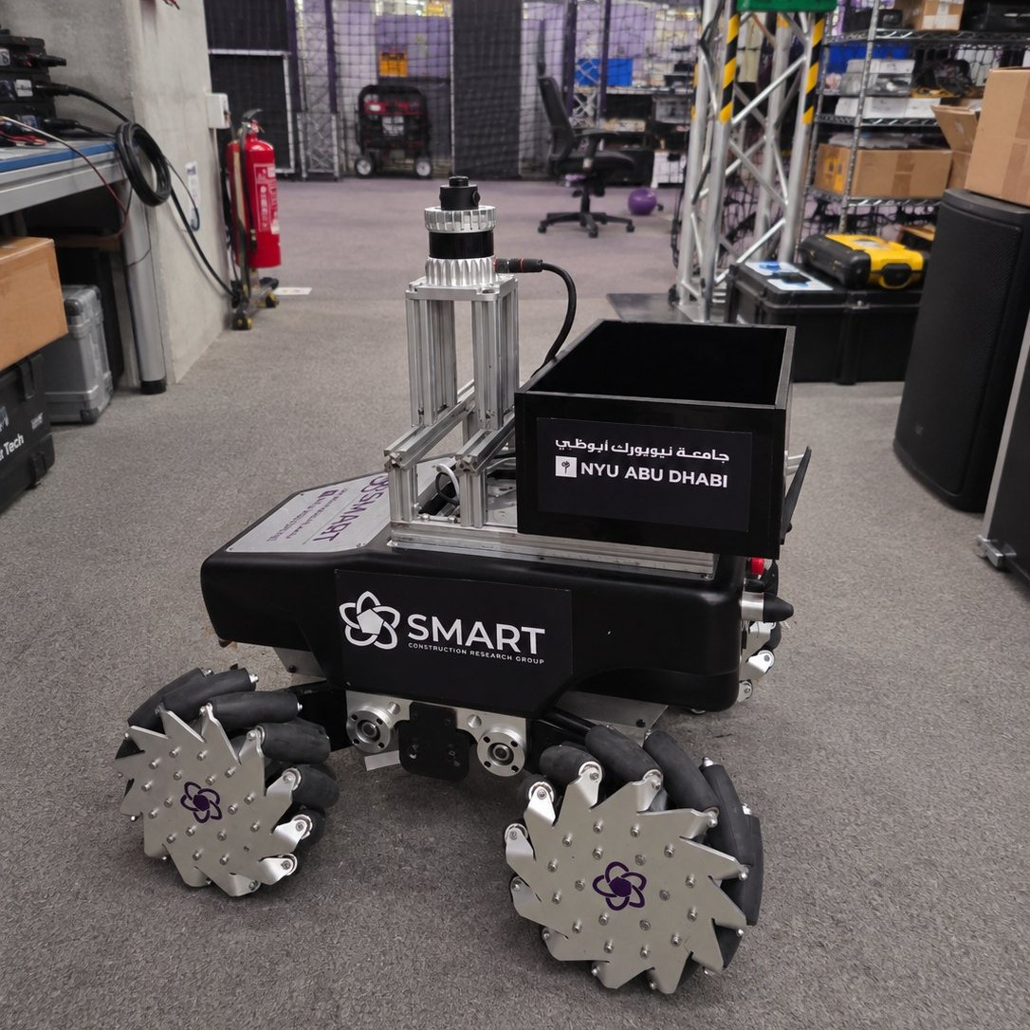
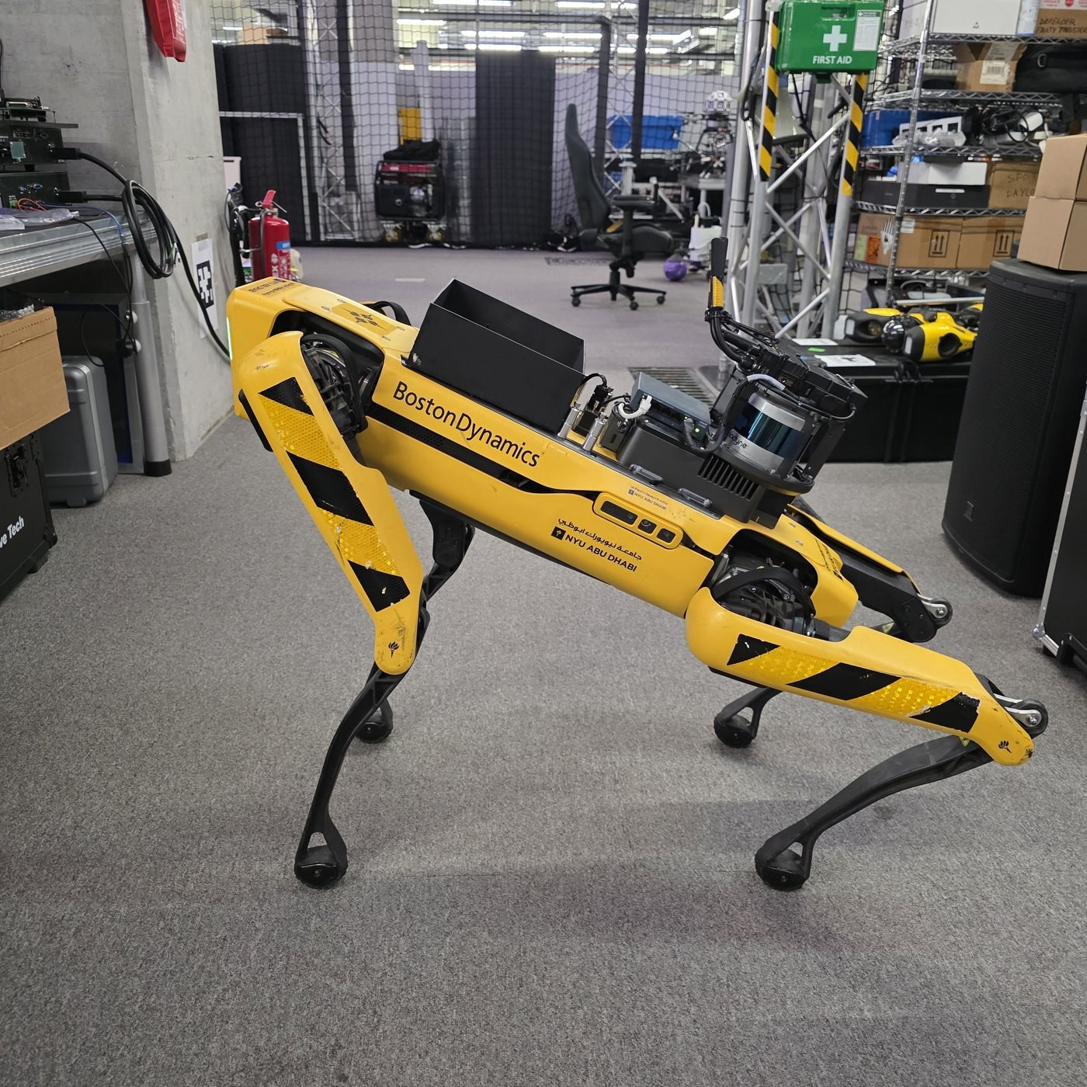
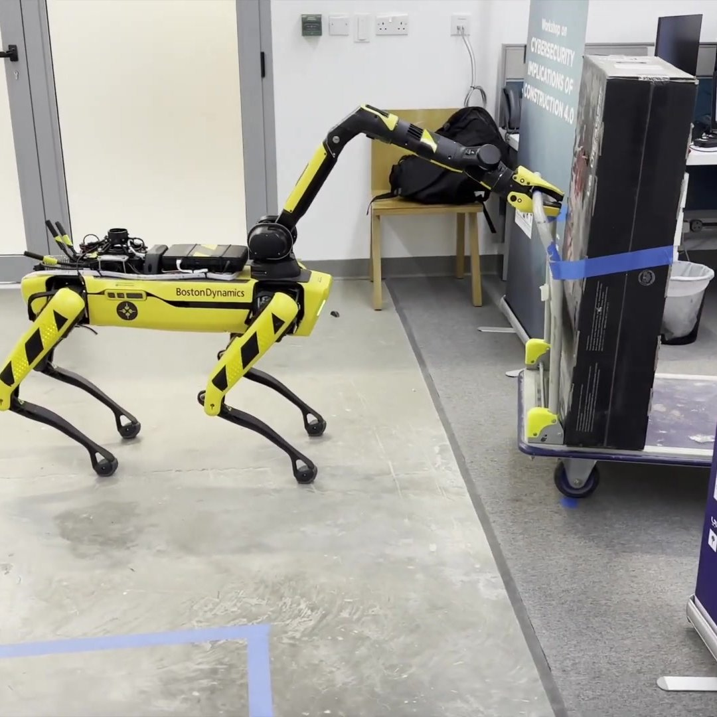
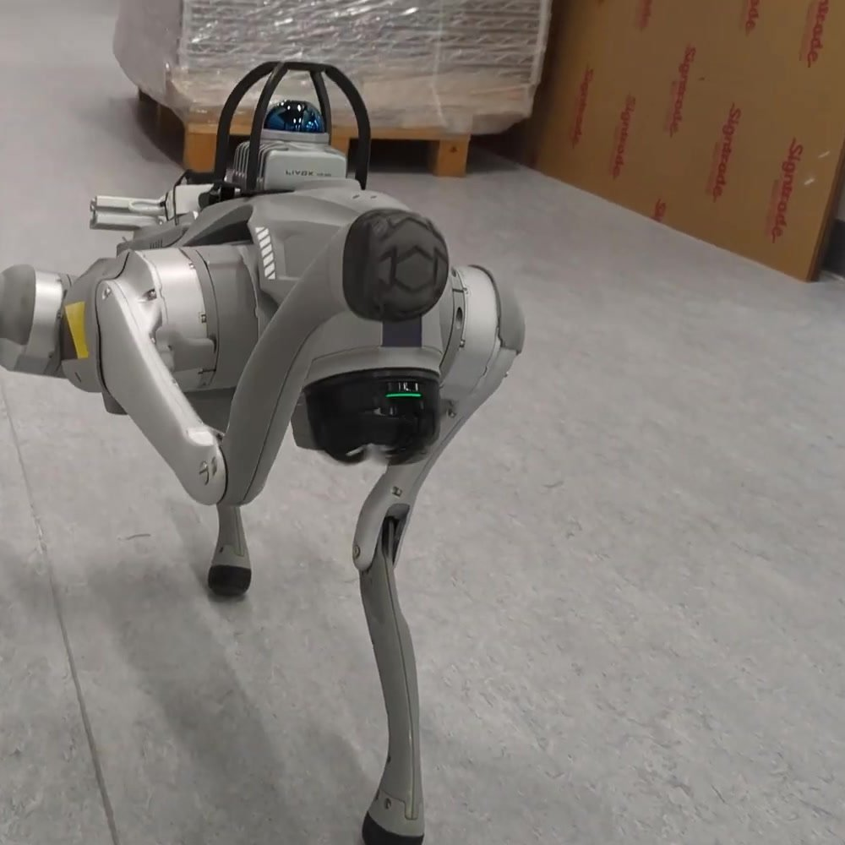
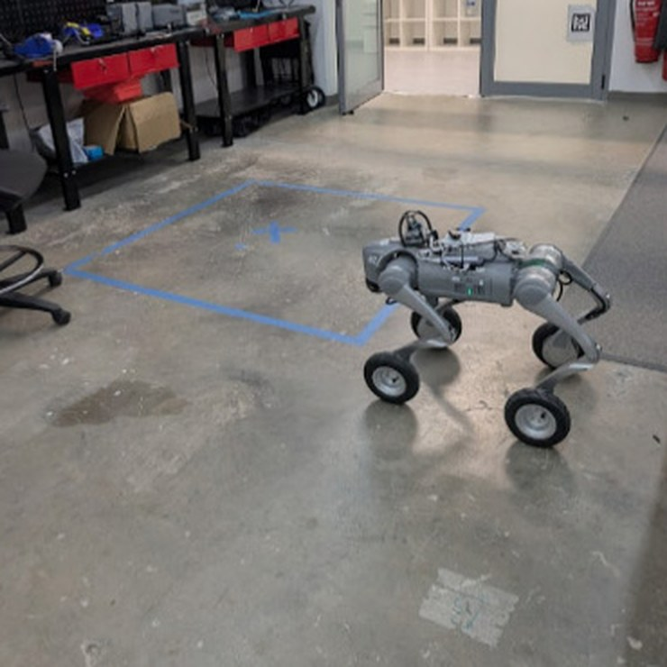
Our Robot Fleet
01 ROBOTS
SUMMIT-XL
Spot
Spot with Arm
Go2
Go2-W
Robotnik · omnidirectional wheeled base
Boston Dynamics · agile quadruped
6-DOF arm with two-finger gripper
Unitree · compact quadruped
Unitree · wheeled-legged hybrid
Used in
Used in
Used in
Used in
Used in
Multi-Agent · Logistics
Multi-Agent · Logistics
Multi-Agent · PACA
LISA (2025)
LISA (2026) · SiteScope

Slide 7
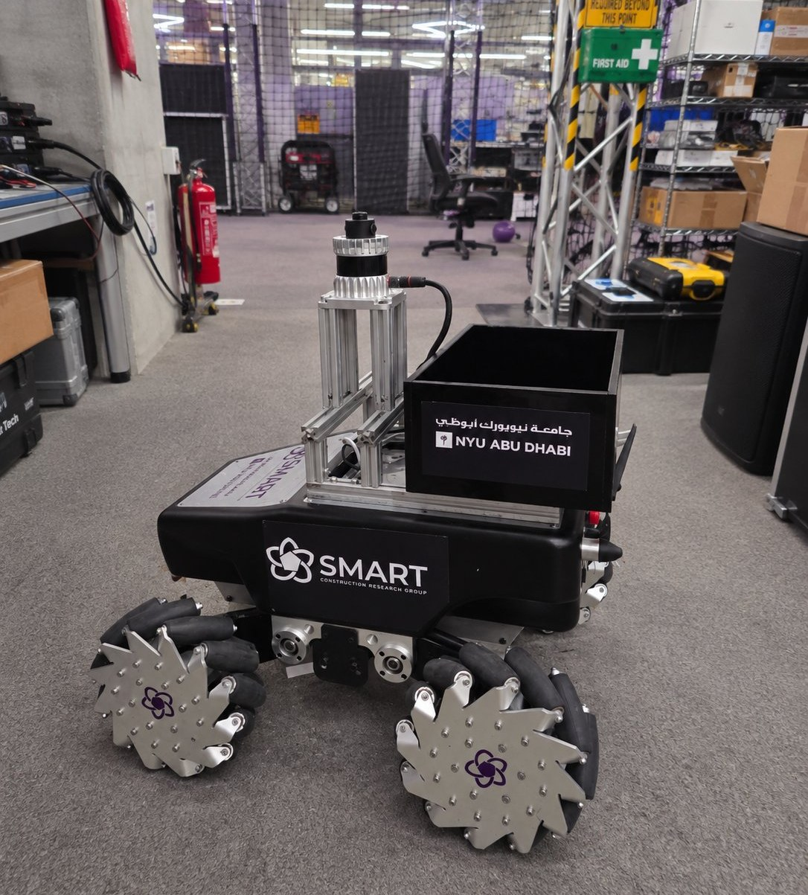

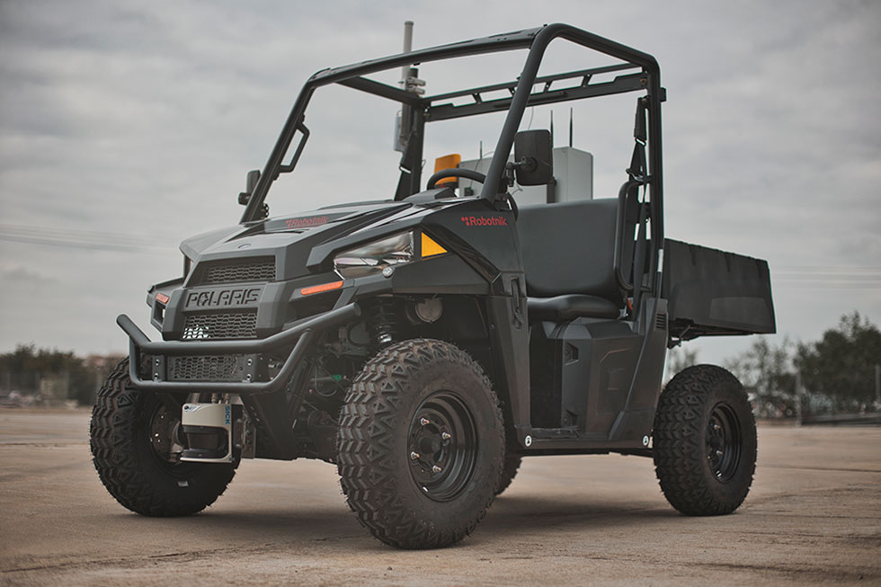
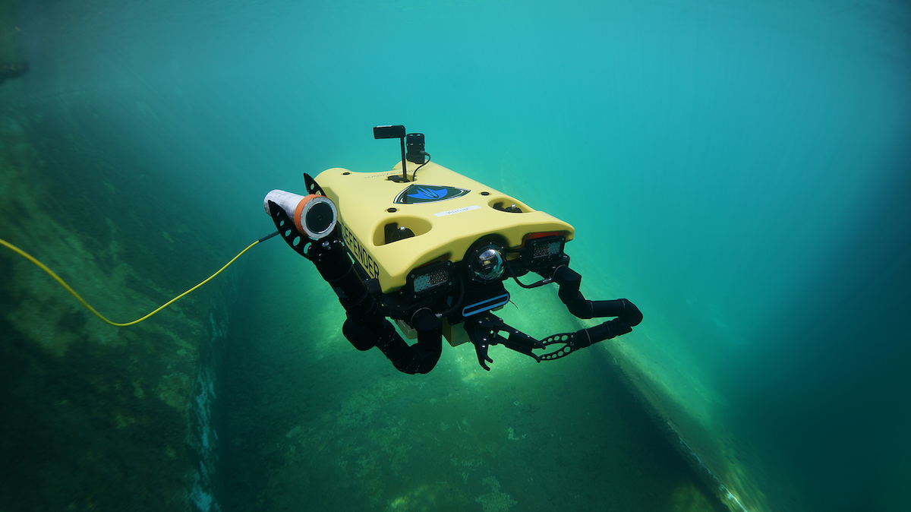

Robotnik SUMMIT-XL
Explorer & 3D Scanner
Omnidirectional mecanum wheels for tight, cluttered rooms.
Ouster OS1 LiDAR (150 m) for SLAM and navigation.
Emesent Hovermap ST: 3D scanning while moving (100 m).
MANET radio (up to 120 Mbps, AES-256) running ROS.

Slide 8
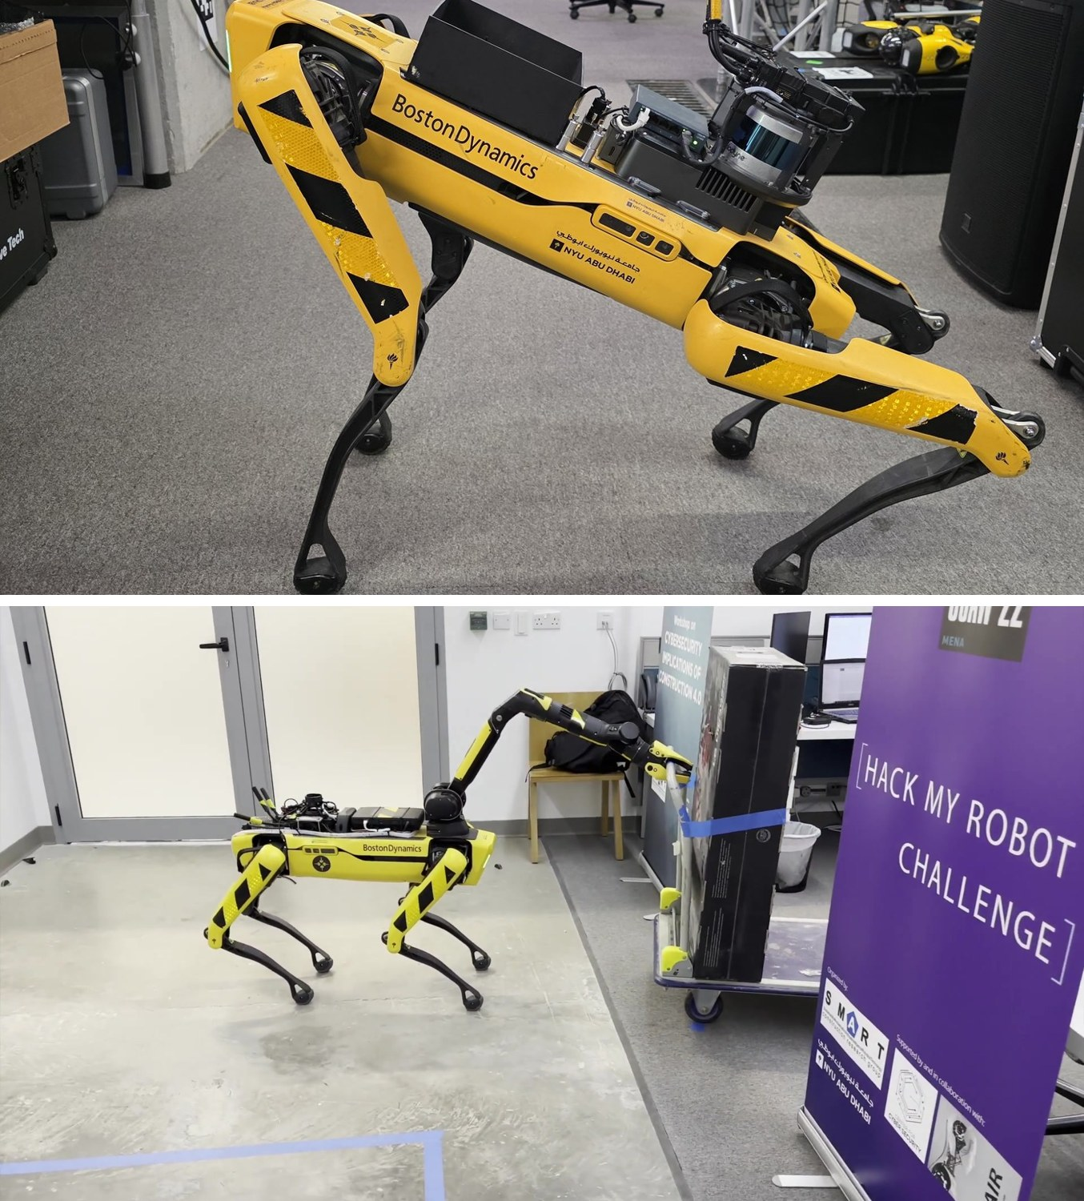
Spot
Boston Dynamics Spot
& Spot with Arm
Spot with Arm
Agile quadruped: stairs, narrow paths, rough ground.
6-DOF arm + gripper: opens doors, moves obstacles.
GPU compute, RGB-zoom/thermal gimbal, 360° camera.
Used in Multi-Agent (RA2), PACA and the Logistics demo.

Slide 9
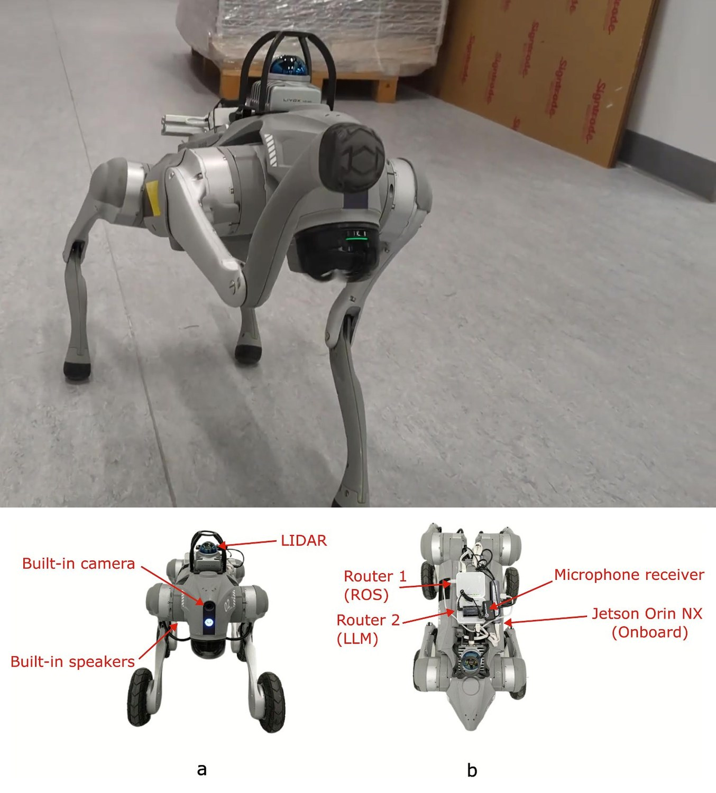
Go2
Unitree Go2 & Go2-W
Edge-AI Assistants
Go2: compact quadruped with built-in camera and speakers.
Go2-W: wheeled-legged hybrid with a Livox MID-360 LiDAR.
NVIDIA Jetson Orin NX 16 GB runs the LLM on the robot.
Wireless mic and push-to-talk clicker: hands-free control.
Go2-W

Slide 10
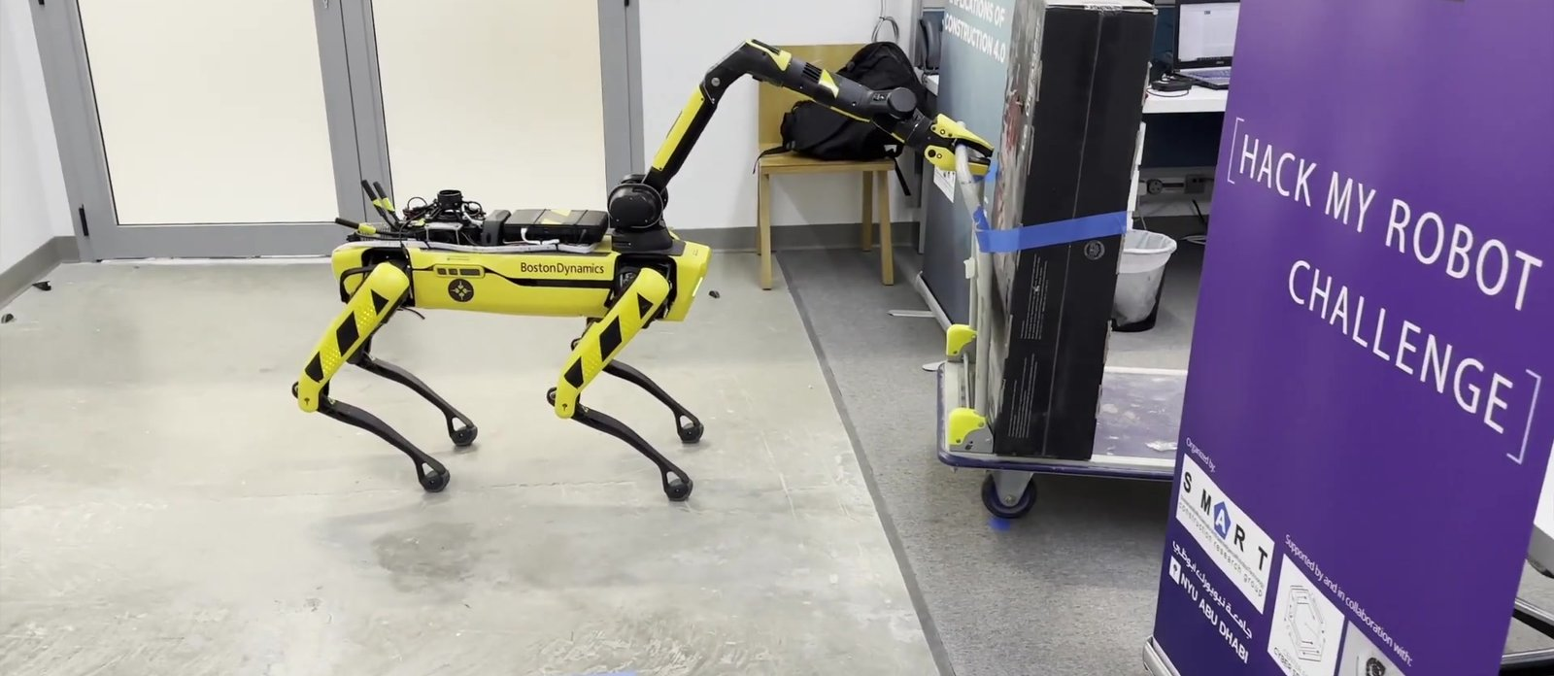
02
Multi-Agent Robotic Systems:
Data Collection on Site

Slide 11
Multi-Agent System | Introduction
02 MULTI-AGENT
The challenge
1
Sites change every day: clutter, closed doors and materials block a single robot.
2
No single robot can scan, open doors and move obstacles.
3
Standard exploration stops when it runs out of frontiers, not when the job is done.
Our idea
A team of robots and a human on one shared network, which splits the work, asks each other for help, and uses the BIM to know how much is left to explore.
2 + 1
~80 m²
robots + human agent
occluded space digitized
[1] Prieto, Giakoumidis & García de Soto (2024). Journal of Field Robotics 41(4), 1187–1203. doi:10.1002/rob.22316

Slide 12
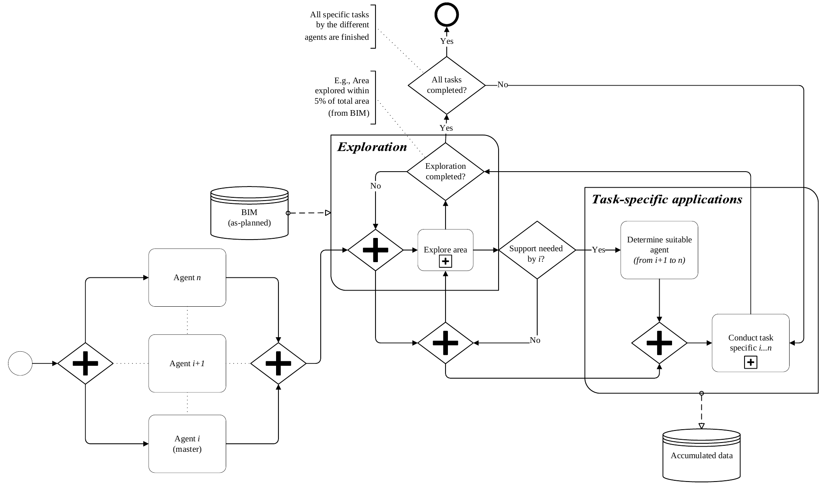
Multi-Agent System | Methodology
02 MULTI-AGENT
1
Start in parallel
All agents launch at once; agent i is the master.
2
Explore
Frontier-based exploration maps the site in real time.
3
Ask for help
A blocked agent calls the best-suited agent (i+1 … n).
4
Stop using BIM
Finish when the explored area reaches the BIM floor plan: φ = ΣPexp / ΣPGT × 100%
BPMN of the multi-agent methodology [1]

Slide 13
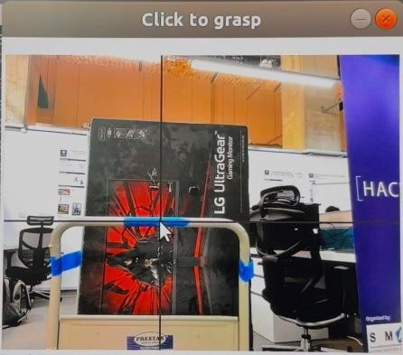
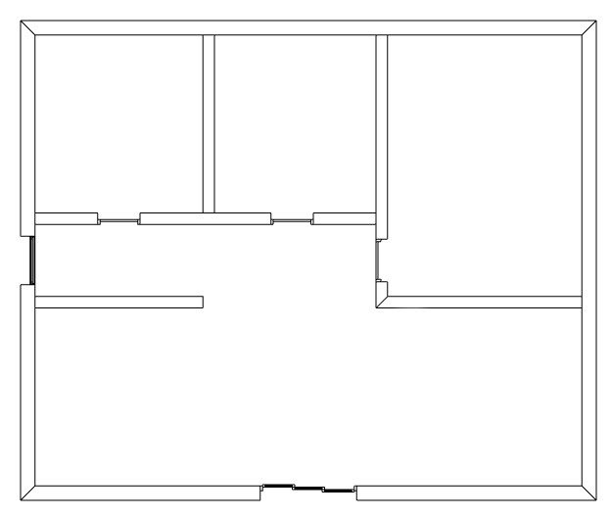

Multi-Agent System | System Components
02 MULTI-AGENT
RA1 · SUMMIT-XL
RA2 · Spot with Arm
Human Agent
Explores and scans: builds the navigation map and the 3D point cloud.
Assists: opens doors and removes obstacles that block RA1.
Supervises remotely and marks a grasp point when the robot asks.
BIM → ground truth
IFC floor plan sliced into a free-space map for the stopping rule.
One shared network
MANET radios: 2.42 GHz · 3×3 MIMO · AES-256
ROS master links all agents and the control station
Custom help-request topic dispatches the right agent

Slide 14
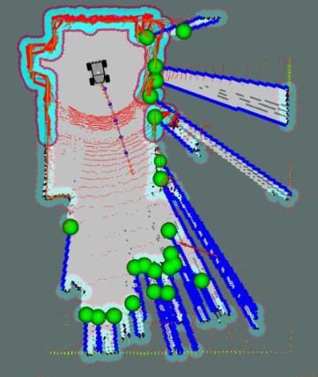
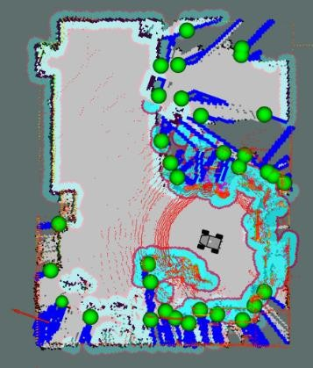
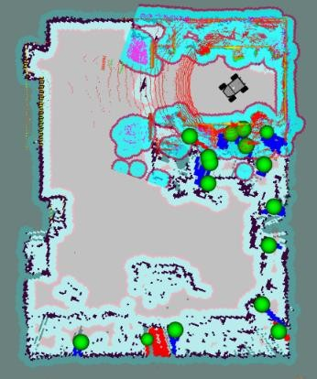
Multi-Agent System | Results
02 MULTI-AGENT
φ = 49.5%
φ = 84.5%
φ = 95.8%
Exploring
Blocked: help requested
Path cleared: done
Why the BIM matters: standard exploration would have stopped at 84.5%, with no frontiers left. Because the explored area was compared with the BIM, the system knew a room was missing and called Spot to clear the way.

Slide 15
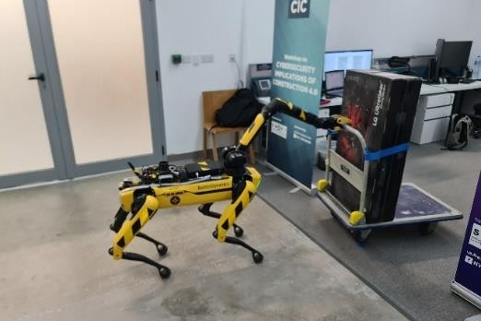
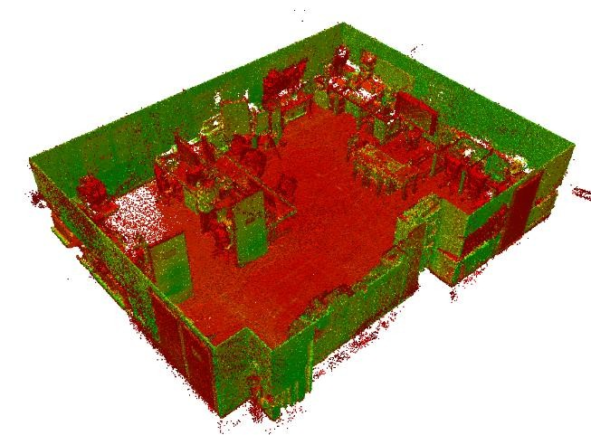
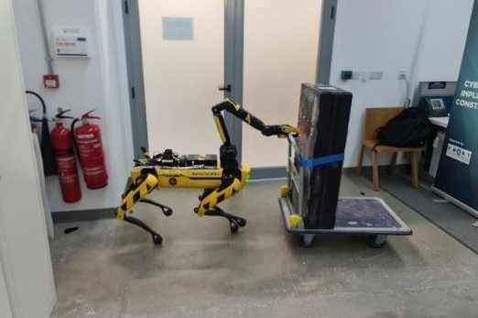
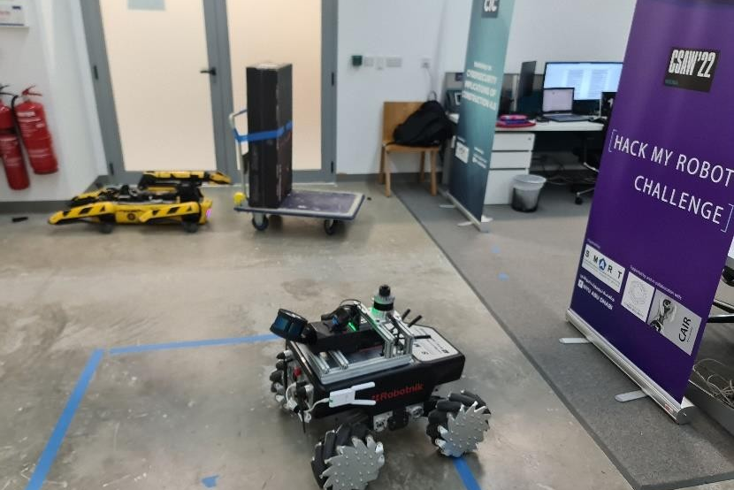
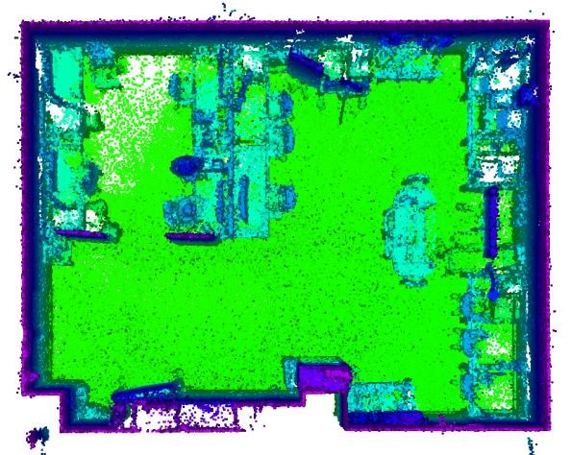
Multi-Agent System | Collaboration & Output
02 MULTI-AGENT
1
2
Human marks the grasp point remotely
Spot grasps the obstacle
3
4
Output
Registered 3D point cloud of the whole space, plus the global map, from a single mission.
…and clears the doorway
SUMMIT-XL resumes exploring

Slide 16
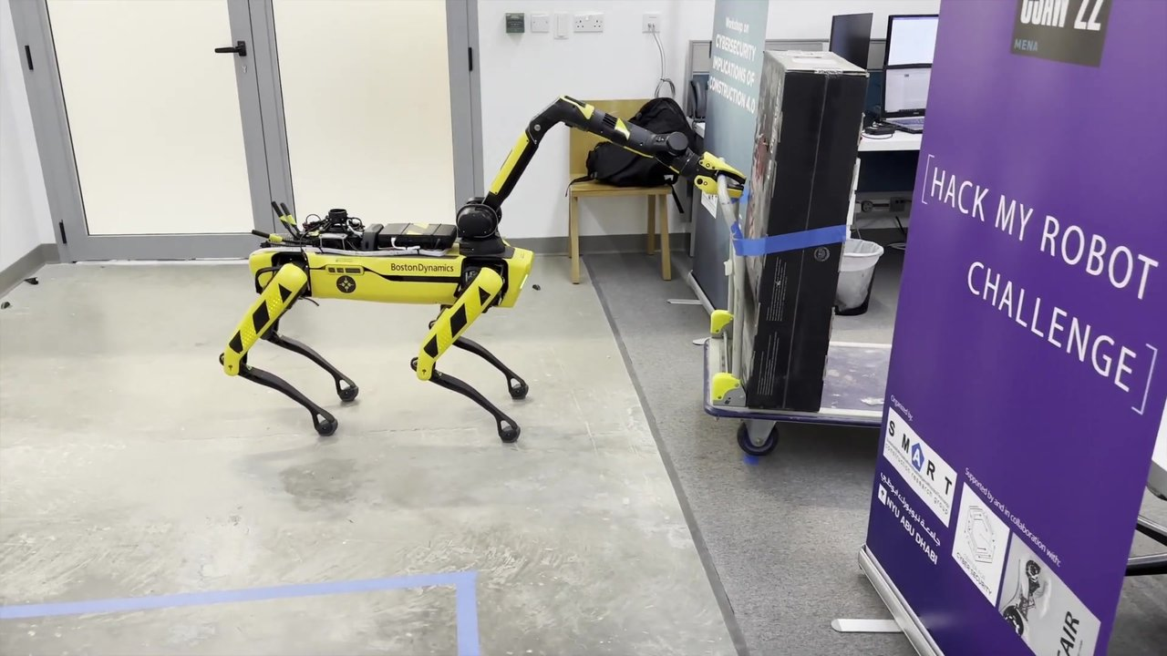
Multi-Agent System | Video
02 MULTI-AGENT
Full video: two robots and a remote human agent digitize an occluded space

Slide 17
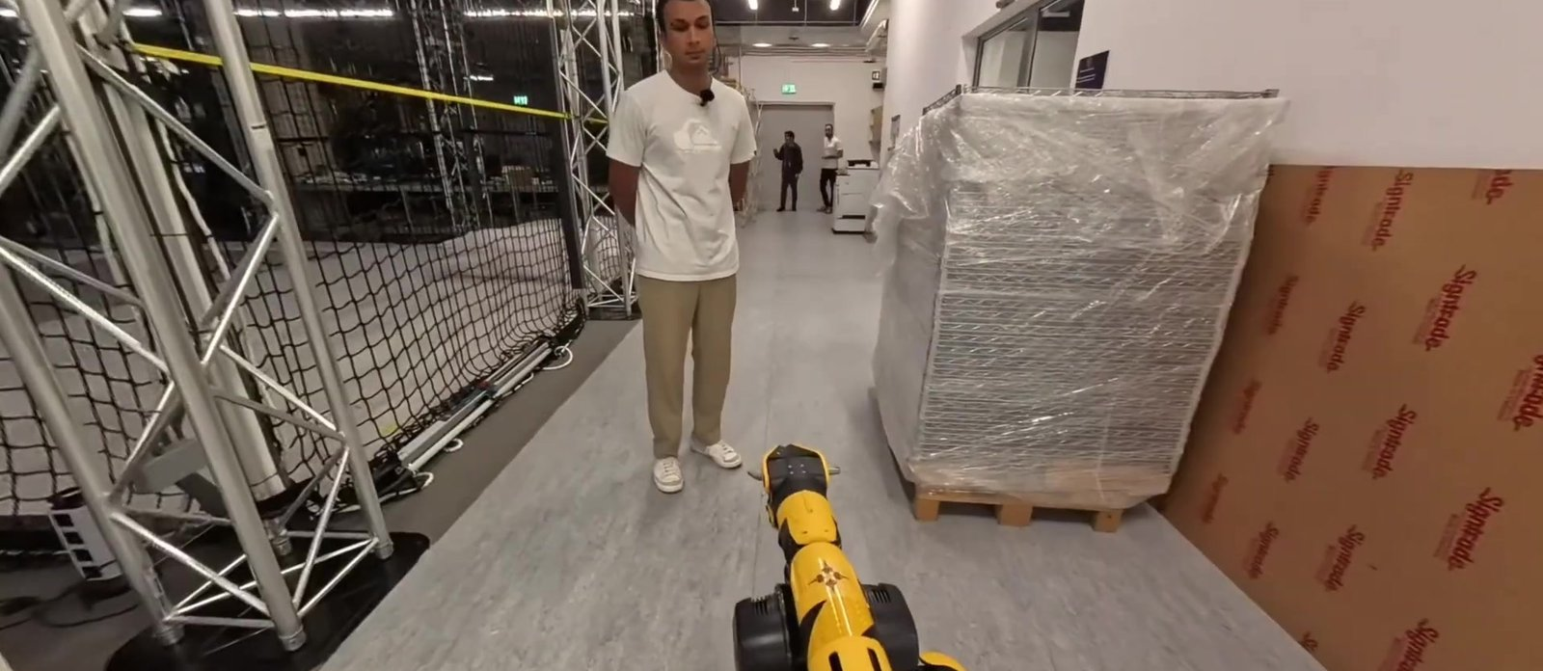
03
PACA: Personal Autonomous
Construction Assistant

Slide 18
PACA | Introduction
03 PACA
The challenge
1
Most site workers have no training in robotics.
2
Tablets and programming interfaces don't work well on site.
3
Multinational crews need to be understood in their own language.
Our idea
Workers simply talk to the robot. A multimodal LLM understands the request, looks at the scene when needed, answers by voice, and turns intent into robot actions.
Voice
Vision
in and out, any language
image-based reasoning
[2] Prieto & García de Soto (2025). PACA. 4th Future of Construction Workshop, IEEE ICRA 2025 (construction-robots.github.io/papers/112.pdf)

Slide 19
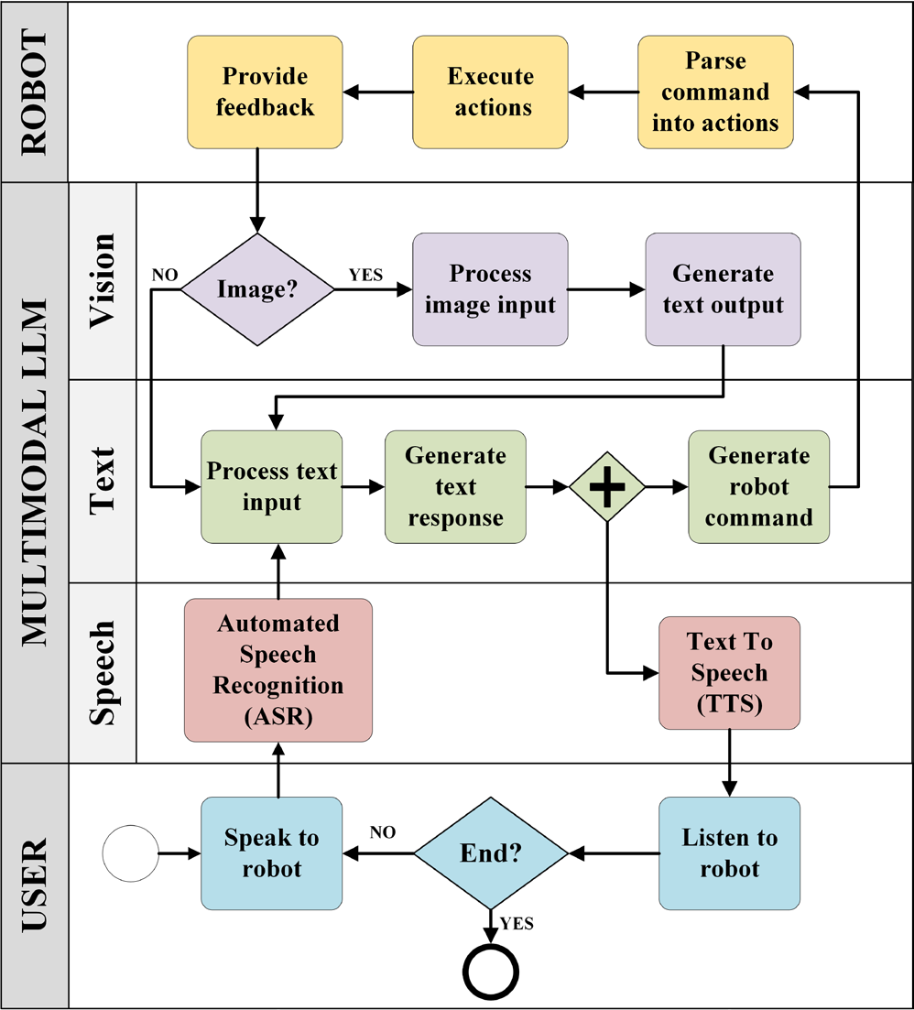
PACA | Methodology
03 PACA
1
Speak
The worker presses a button and talks; a hard-hat microphone captures the audio.
2
Understand
Speech-to-text (whisper-1) feeds a multimodal LLM (gpt-4-turbo) whose system prompt lists the tasks and the robot API.
3
See
When needed, the arm camera takes a picture for image-based reasoning.
4
Act and reply
Outputs are parsed into Spot API actions; text-to-speech (tts-1) streams the reply.

Slide 20
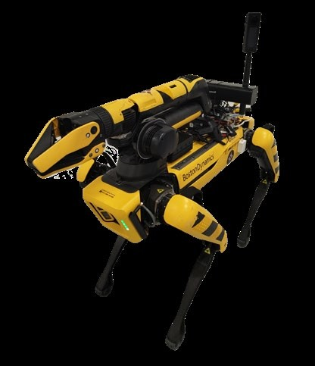
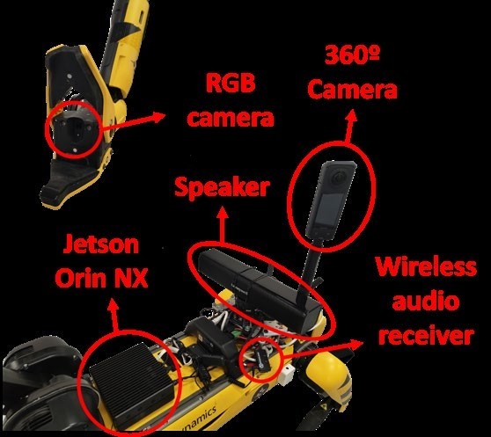
PACA | Implementation on Spot
03 PACA
Hardware
Jetson Orin NX 16 GB
Hard-hat mic + wireless receiver
Speaker · arm RGB camera
Insta360 X4 · remote button
Software
ASR: whisper-1
LLM: gpt-4-turbo (cloud)
TTS: tts-1, streamed
Boston Dynamics Python API
Spot with Arm carrying the PACA payload [2]
Robot actions: go to inventory · go to worker · take picture · pick up tool

Slide 21
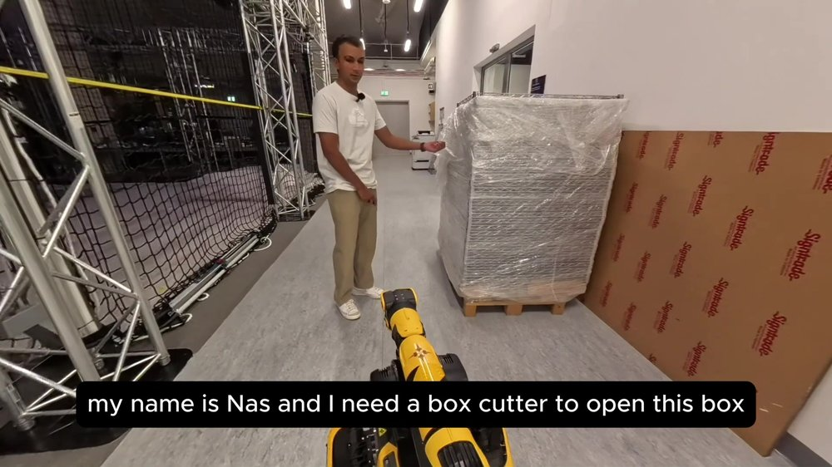
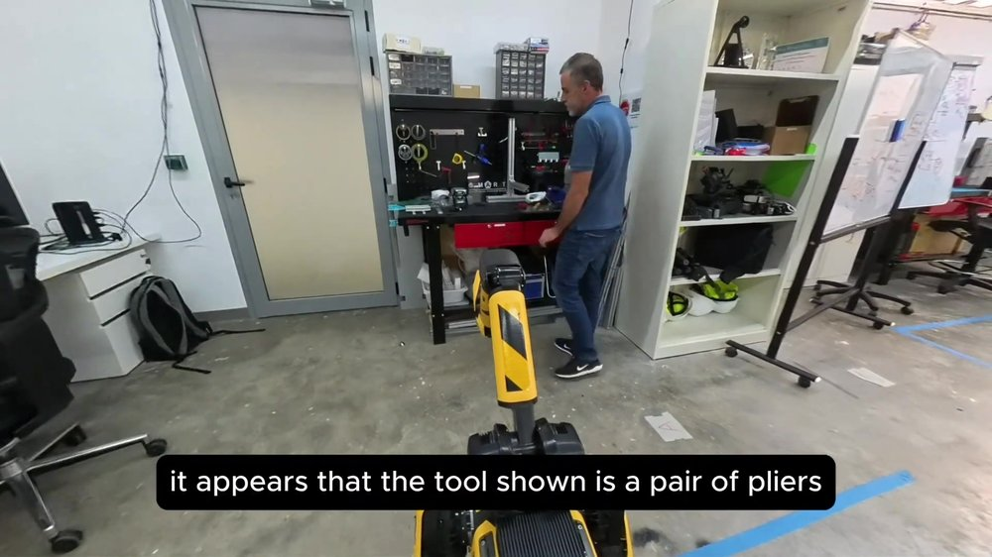
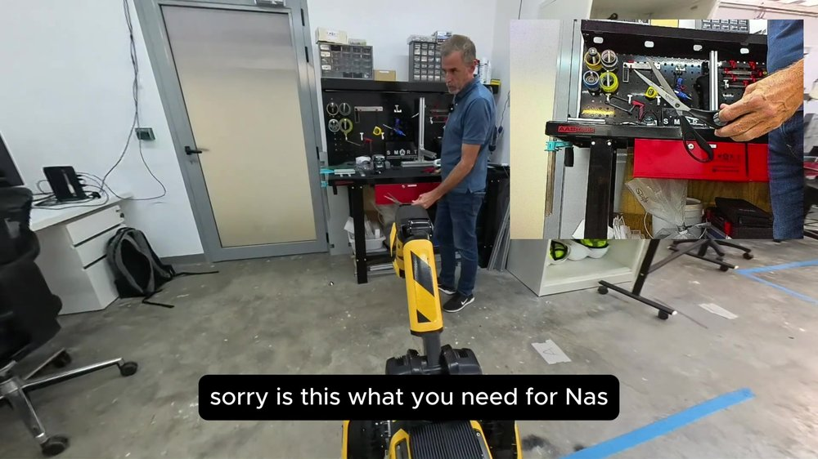
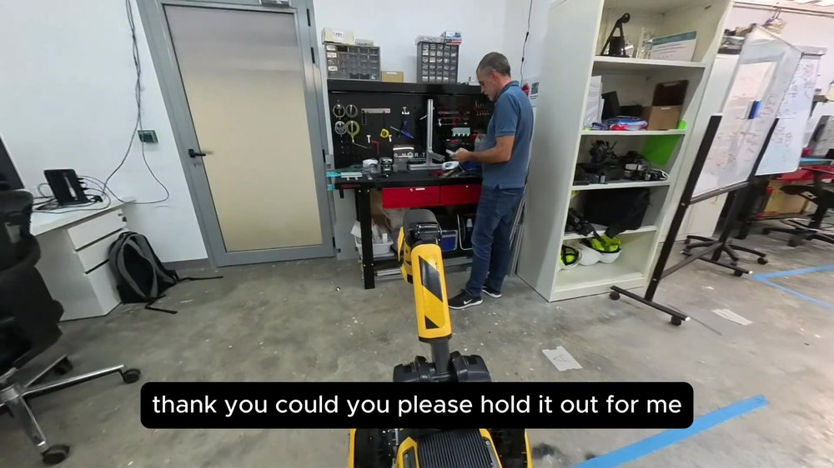
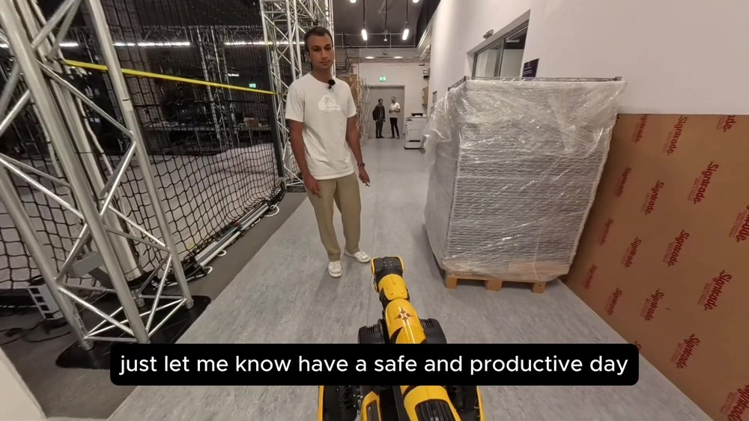
PACA | Case Study: Fetching a Tool
03 PACA
1
2
3
A worker asks PACA for a box cutter.
Wrong tool shown: PACA sees pliers and asks again.
The right tool is shown and confirmed.
4
5
What it shows
Dialogue with two people: worker and inventory manager
Vision rejects the wrong tool
Next: cloud dependency adds latency, which led to LISA
PACA asks the manager to hold it out and grasps it.
The tool is delivered back to the worker.

Slide 22

PACA | Video
03 PACA
Full video: PACA fetches a tool for a worker through spoken dialogue

Slide 23
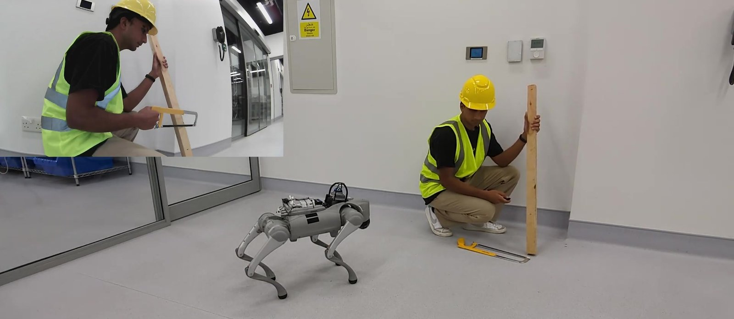
04
LISA: Local Intelligent
Safety Assistant

Slide 24
LISA | Introduction
04 LISA
The challenge
1
Cloud LLMs need a stable connection, which construction sites rarely have.
2
Latency: cloud replies took over 45 s on low bandwidth.
3
Site images and workers' voices are sensitive data.
Our idea
Run speech, vision and the LLM on site, on the robot or a nearby edge server, so the assistant keeps working offline and data never leaves the site.
> 45 s
5–10 s
cloud reply, low bandwidth
LISA reply, fully on-device
[3] Gopee, Prieto & García de Soto (2025). CCC 2025. doi:10.22260/CCC2025/0041 [4] Gopee, Prieto & García de Soto (2026). Autom. Constr. 183, 106805. doi:10.1016/j.autcon.2026.106805

Slide 25
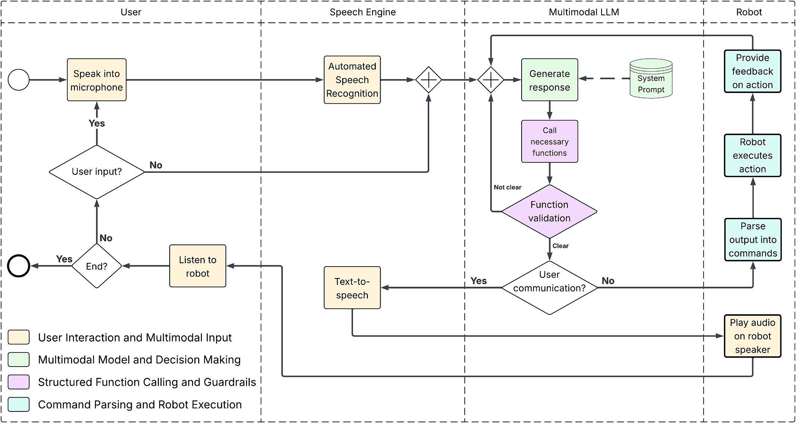
LISA | Methodology
04 LISA
Five robot functions
navigate_to(location)
take_picture()
analyze_image()
speak(text)
activate_safety_protocol()
Guardrails
Every call is checked against a fixed schema before it runs; anything invalid falls back to dialogue.
BPMN of the LISA framework; navigation runs through ROS 2 (Nav2 + AMCL) [4]

Slide 26
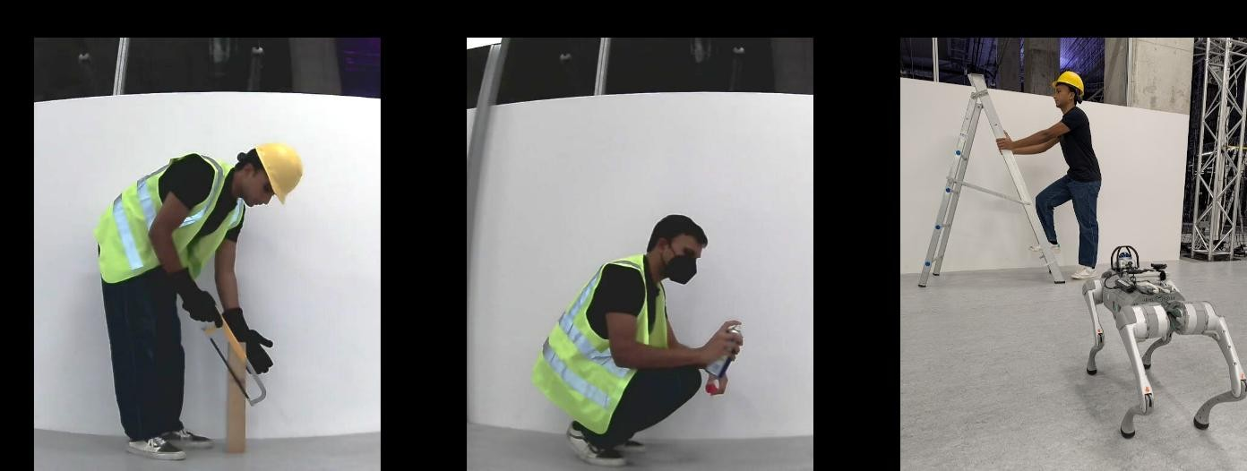
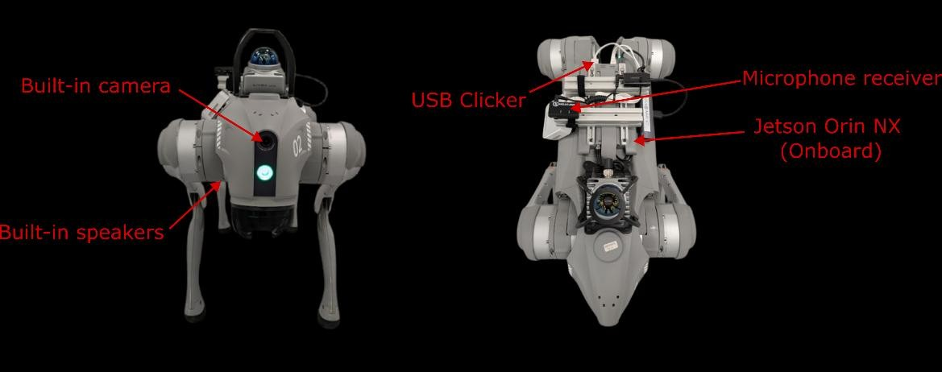
LISA v1 | Fully On-Device on Go2
04 LISA
Activity | Required PPE | LISA's verdict
Cutting wood | Hard hat, vest, gloves | ✓ Compliant
Aerosol use | Hard hat, vest, mask | ✗ Missing hard hat
Climbing ladder | Hard hat, vest, harness | ✗ Missing vest, harness
Everything runs on the robot
Gemma 3 12B
Whisper base (ASR)
Piper TTS
Jetson Orin NX 16 GB
Push-to-talk
5–10 s
0
typical spoken reply
cloud calls
PPE compliance test: images captured by the Go2's own camera [3]

Slide 27
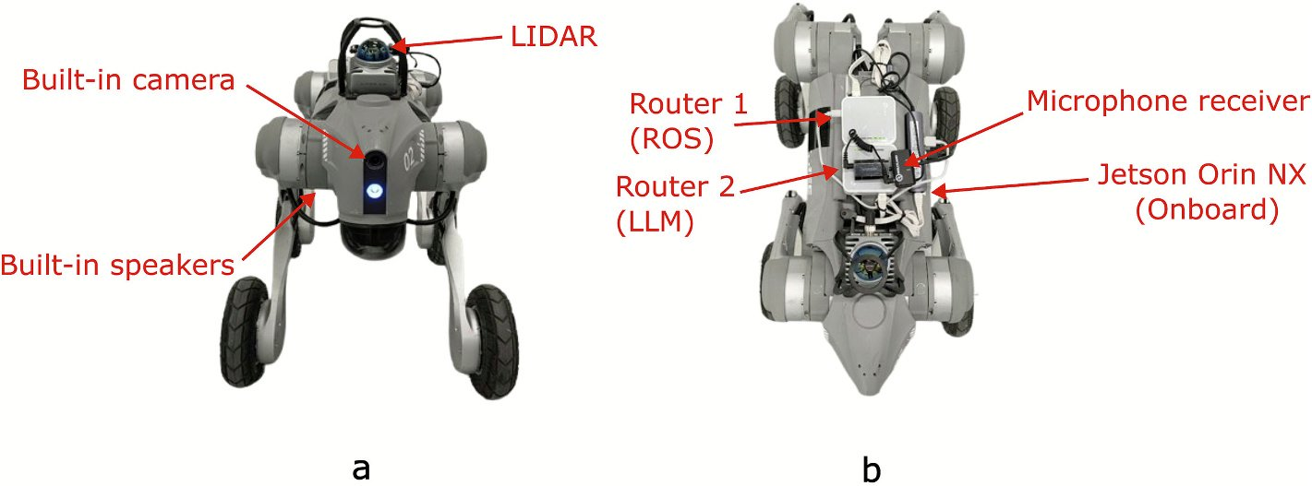
LISA v2 | On-Robot vs. Edge Server
04 LISA
ON-ROBOT
EDGE SERVER
Gemma 3 4B
Gemma 3 27B
Jetson Orin NX 16 GB
RTX 4090 workstation, same LAN
Works fully offline
More reasoning; data stays on site
Four workflows of increasing complexity · 2 models × 4 experiments × 5 runs = 40 runs
1
5
6
13
step · Exp 1
steps · Exp 2
steps · Exp 3
steps · Exp 4
“Go to the work area.”
“Inspect the work area.”
“Inspect and report back at the station.”
PPE violation detected
A single navigation call
Navigate, photo, analyze, speak
Adds a return trip
Warn worker, fetch hard hat, report

Slide 28
LISA v2 | Results
04 LISA
2.45–3.18 s
100%
76.5%
faster per step with 27B (p < 0.001)
27B success, 0 extra steps, all workflows
4B success in Exp 4, with 46% more steps

Slide 29

LISA v2 | Where Each Model Wins
04 LISA
Go2-W at the station, storage area and work area during the tests [4]
Takeaway: hybrid deployment
Send vision tasks to the 27B edge model (about 2.7× faster).
Keep the 4B model on the robot for navigation and as an offline fallback.
Image tasks: 2.79 s vs 7.67 s. Navigation: 3.24 s vs 4.73 s; the 4B model was faster in one case.

Slide 30

LISA | Video
04 LISA
Full video: LISA runs a PPE safety check entirely on the Go2, with no cloud connection

Slide 31
References
1
Prieto, S. A., Giakoumidis, N., & García de Soto, B. (2024). Multiagent robotic systems and exploration algorithms: Applications for data collection in construction sites. Journal of Field Robotics, 41(4), 1187–1203.
https://doi.org/10.1002/rob.22316
2
Prieto, S. A., & García de Soto, B. (2025). PACA: A Personal Autonomous Construction Assistant to facilitate human-robot interaction. 4th Workshop on the Future of Construction, IEEE ICRA 2025, Atlanta, USA.
No DOI · https://construction-robots.github.io/papers/112.pdf
3
Gopee, M. A., Prieto, S. A., & García de Soto, B. (2025). Enhancing human-machine interaction with on-device large language models in construction robotics: A case study on safety applications. Proc. Creative Construction Conference 2025.
https://doi.org/10.22260/CCC2025/0041
4
Gopee, M. A., Prieto, S. A., & García de Soto, B. (2026). Self-hosted multimodal large language models for speech-driven perception and navigation in construction robotics. Automation in Construction, 183, 106805.
https://doi.org/10.1016/j.autcon.2026.106805

Slide 32




THANK YOU
Borja García de Soto, PhD, PE
Associate Professor
garcia.de.soto@nyu.edu

